Slide 1
Procedure for Verilog Tool Installation and Running.
Shriram K Vasudevan

Slide 2
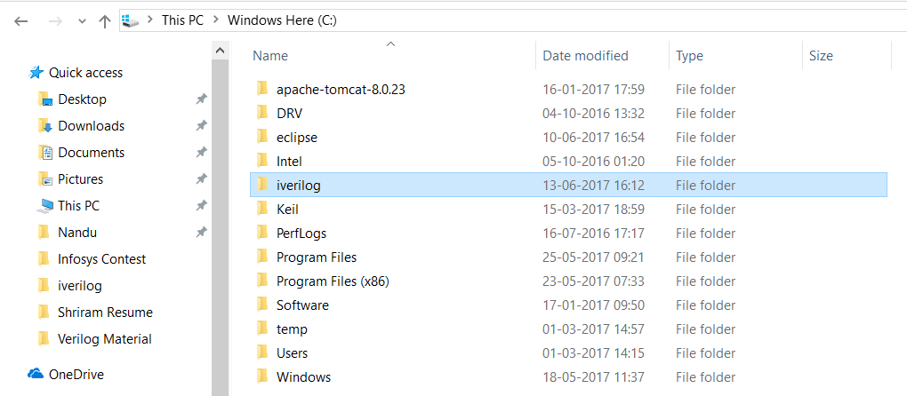
Let’s Run Verilog
Download Verilog for Windows from
http://bleyer.org/icarus/
Install it as usual.
You shall have a directory named iverilog in C drive.

Slide 3
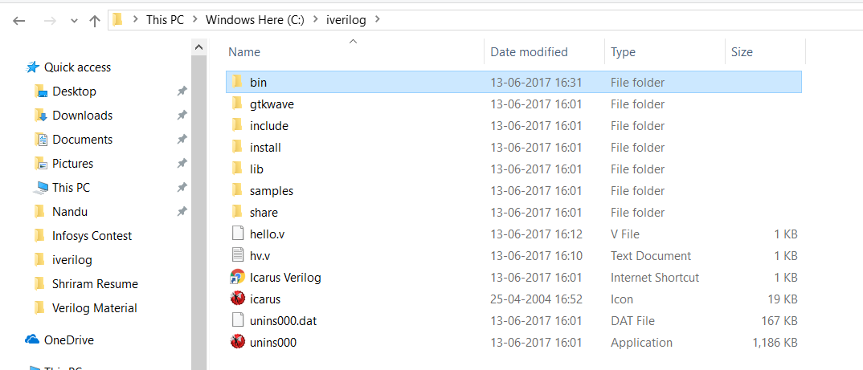
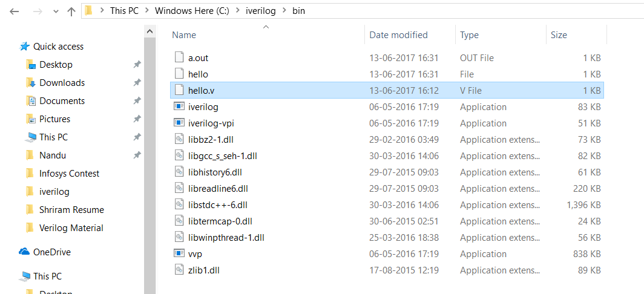
Contd.,
Now, go into the folder iverilog
You will have bin. Do nothing ☺
Go into bin, store your files there.
Files should have extension .v
Use notepad ++ as you can save it easily.

Slide 4

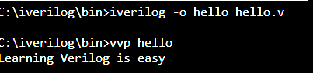
Contd.,
To run a file, you should recollect the steps we did with GCC.
It’s similar!
Go to CMD Prompt.
Navigate to C:\iverilog\bin>
Now, you can run your file. ☺ See the snapshot with both the options.
Happy Verilog Learning Folks!

Slide 5
Thanks
Shriram

